Slide 1

Financial Accounting
CHAPTER 6
TRIAL BALANCE AND FINAL ACCOUNTS
Dr. Smita Jape
Dr.V.N.Bedekar Institute of
Management Studies

Slide 2
Final Accounts
Financial Statements /Annual Statements of Business (Companies )

Slide 3
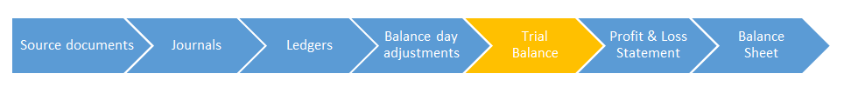
Trial Balance
A trial balance is a bookkeeping worksheet-like account that reflects all the credit and debit balances of all the ledger accounts. Once we prepare this statement, we can prepare the final accounts of the company on the basis of this trial balance.
One other important use of the trial balance is that it can determine the arithmetic accuracy of the accounts. So if both columns of the trial balance tally, we can be reasonably assured of the accuracy of the accounts. It does not ensure that the accounts are free of all errors but it can at least establish mathematical accuracy.

Slide 4
While preparation of trial balances we must take care of the following rules/points
1] The balances of the following accounts are always found on the debit column of the trial balance
Assets
Expense Accounts
Drawings Account
Cash Balance
Bank Balance
Any losses And the following balances are placed on the credit column of the trial balance
Liabilities
Income Accounts
Capital Account
Profits

Slide 5
Ledger account balances to be recorded in debit money column | Ledger account balances to be recorded in credit money column
All assets Land, building, leasehold property, machinery, furniture, investment, notes receivable, accounts receivable, cash, stock, goodwill, patents, trademarks, etc.. | External liabilities The loan, mortgage loan, accounts payable, notes payable, debenture, bank overdraft, etc..
All expenses Wages expense, salary expense, supplies expense, advertisement expense, rent expense, repair expense, interest expense, commission expense, depreciation expense, bad debt expense, discount expense, Items for which payment is made: Owner’s goods withdrawal, merchandise purchase. | All Incomes Rent revenue, discount income, interest income, apprenticeship premium income etc..
Prepaid expense Prepaid insurance, prepaid rent, prepaid advertisement, salary advance etc.. | Expense payable Salaries payable, rent payable.
Accrued income Interest on investment accrued, interest on bank balance accrued, interest accrued on notes receivable and accounts receivable. | Losses Cash lost, goods lost etc.
Unearned income Unearned rent, unearned premium, etc.. | All types of reserves and provisions General reserve, provision for doubtful debts. Provision for discount on accounts receivable, etc..
Other items Sales return, reserve for, discount on accounts payable. | Other items Purchase return, capital, bad debt recovered.

Slide 6
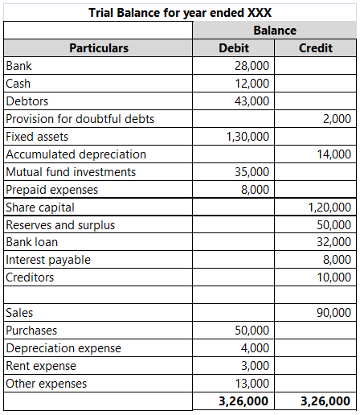
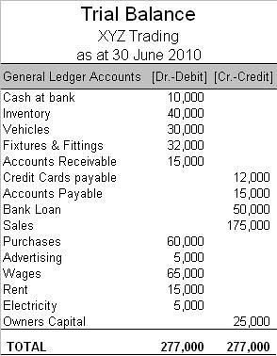

Slide 7
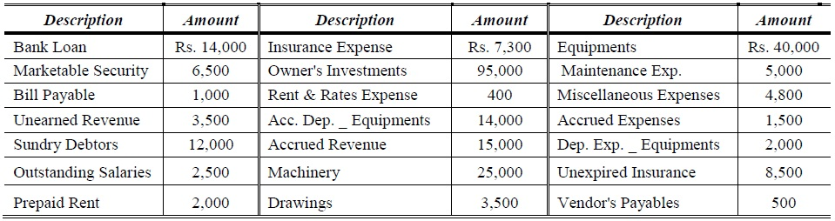
Prepare a Trial Balance for Shining Brothers Pvt. Ltd. at March 31st, 2017?

Slide 8
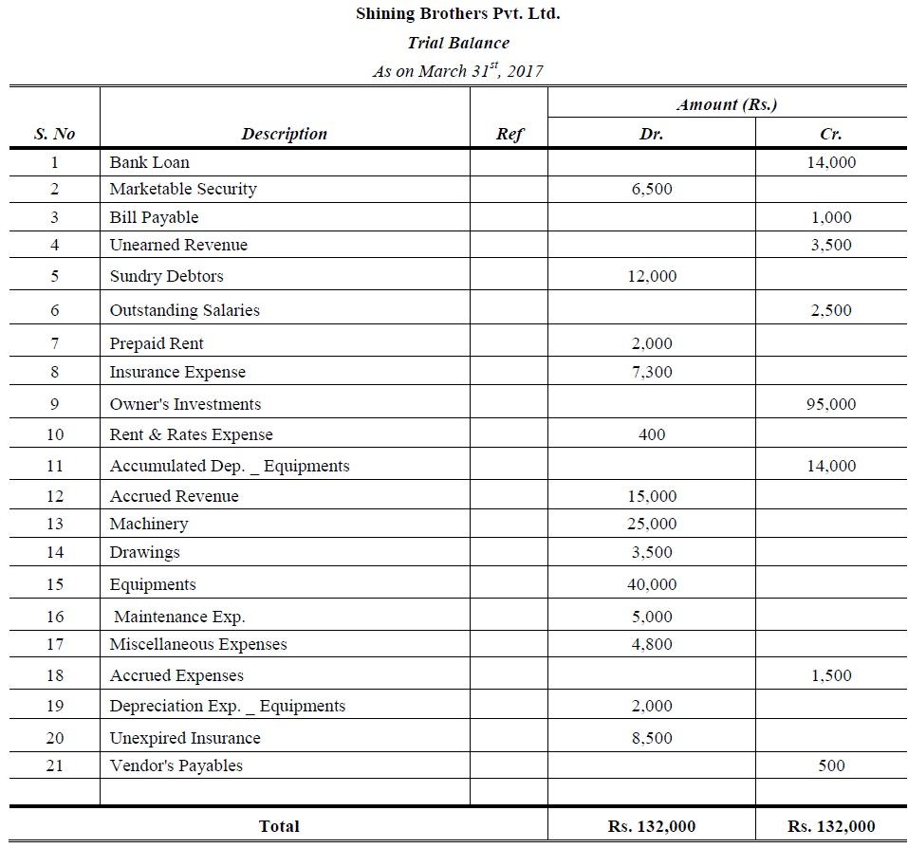

Slide 9
Final Accounts Meaning
Final accounts are those accounts that are prepared by a joint stock company at the end of a fiscal year. The purpose of creating final accounts is to provide a clear picture of the financial position of the organisation to its management, owners, or any other users of such accounting information.
Final account preparation involves preparing a set of accounts and statements at the end of an accounting year. The final account consists of the following accounts:
Trading and
Profit and Loss Account
Balance Sheet
Objectives of Final Account preparation
Final accounts are prepared with the following objectives:
To determine profit or loss incurred by a company in a given financial period
To determine the financial position of the company
To act as a source of information to convey the users of accounting information (owners, creditors, investors and other stakeholders) about the solvency of the company.

Slide 10
Trading Account
Trading account is used to determine the gross profit or gross loss of a business which results from trading activities. Trading activities are mostly related to the buying and selling activities involved in a business. Trading account is useful for businesses that are dealing in the trading business. This account helps them to easily determine the overall gross profit or gross loss of the business. The amount thus determined is an indicator of the efficiency of the business in buying and selling.
The formulae for calculating gross profit is as follows:
Gross profit = Net sales – Cost of goods sold
Where
Net sales = Gross sales of the business minus sales returns, discounts and allowances.
The trading account considers only the direct expenses and direct revenues while calculating gross profit. This account is mainly prepared to understand the profit earned by the business on the purchase of goods.
Items that are seen in the debit side includes purchases, opening stock and direct expenses while credit side includes closing stock and sales.

Slide 11
Profit and Loss Account
Profit and loss account shows the net profit and net loss of the business for the accounting period. This account is prepared in order to determine the net profit or net loss that occurs during an accounting period for a business concern.
Profit and loss account get initiated by entering the gross loss on the debit side or gross profit on the credit side. This value is obtained from the balance which is carried down from the Trading account.
A business will incur many other expenses in addition to the direct expenses. These expenses are deducted from the profit or are added to gross loss and the resulting value thus obtained will be net profit or net loss.
The examples of expenses that can be included in a Profit and Loss Account are:
1. Sales Tax ,2. Maintenance ,3. Depreciation
4. Administrative Expense,5. Selling and Distribution Expense
6. Provisions ,7. Freight and carriage on sales ,8. Wages and Salaries
appear in the debit side of Profit and Loss Account
Commission received, Discount received, profit obtained on sale of assets appear on the credit side.
Net profit can be determined by deducting business expenses from the gross profit and adding other incomes obtained

Slide 12
What is a Balance Sheet?
The Balance Sheet is a statement that shows the financial position of the business. It records the assets and liabilities of the business at the end of the accounting period after the preparation of trading and profit and loss accounts
‘Not-for-Profit’ Organisations design Balance Sheet for determining the financial position of the establishment. The preparation of the balance sheet is on the same pattern as of the trade entities. It depicts liabilities and assets as during the end of the year. Assets are depicted on the right-hand side, whereas the liabilities are depicted on the left-hand side.
However, there will be a General Fund or Capital Fund in place of the Capital and the surfeit or deficit as per Income and Expenditure A/c which is either deducted from or added to the capital fund, as the scenario may be. It is a common practice to add some of the subsidised items like entrance fees, legacies and life membership fees precisely in the capital fund.

Slide 13
Features of a balance sheet
It is regarded as the last step in final accounts creation
It is a statement and not an account
It consists of transactions recorded under two sides namely, assets and liabilities. Assets are placed in the left hand side, while the liabilities are placed on the right hand side
The total of both side should always be equal
The balance sheet discloses financial position of the business
It is prepared after trading and profit and loss account is prepared.
All the above are mentioned balance sheet items are also known as characteristics of the balance sheet.

Slide 14
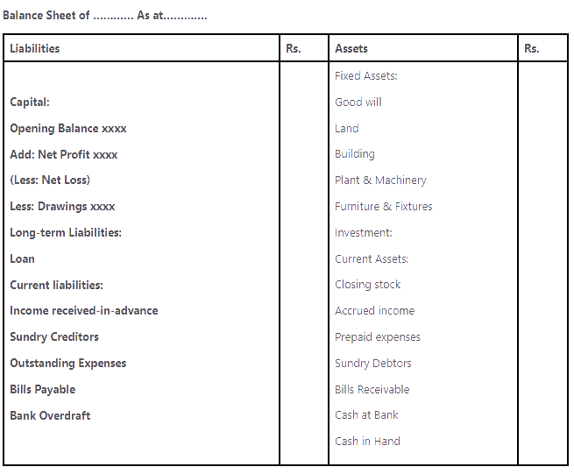
FORMAT Balance sheet

Slide 15
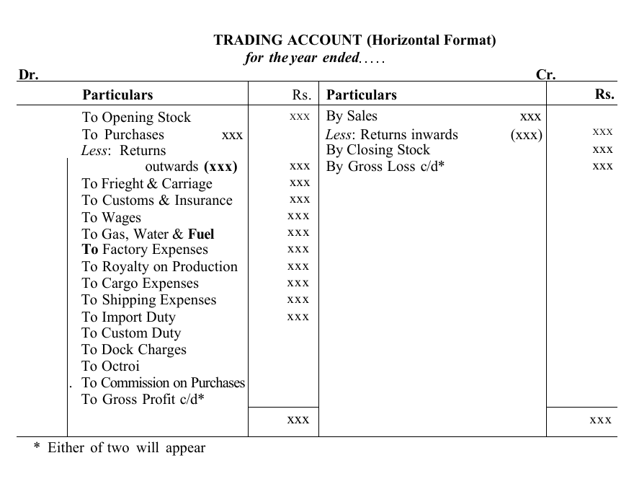
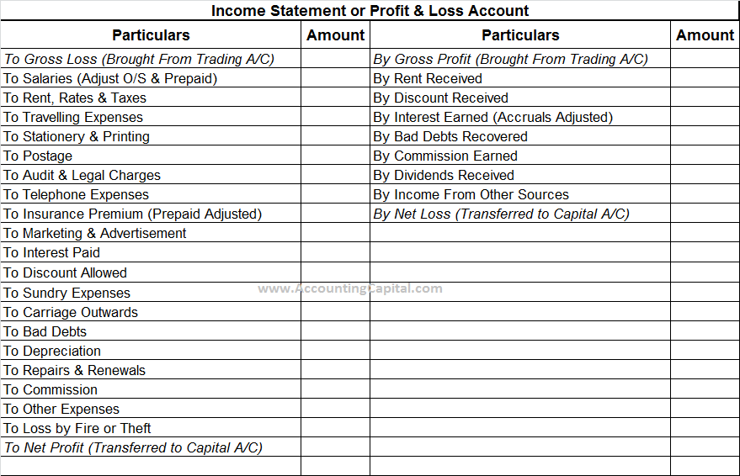

Slide 16
Importance of Balance Sheet:
Balance sheet analysis can say many things about a company’s achievement. Few essential factors of the balance sheet are listed below:
Creditors, investors, and other stakeholders use this financial tool to know the financial status of a business.
It is used to analyse a company’s growth by comparing different years.
While applying for a business loan, a company has to submit a balance sheet to the bank.
Stakeholders can find out the business accomplishment and liquidity position of a company.
Company’s balance sheet analysis can detect business expansion and future expenses.

Slide 17
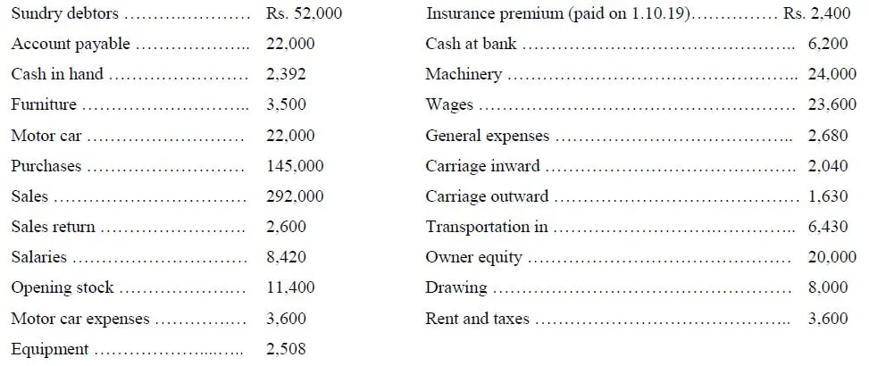
From the following particulars taken out from the books of Mr ABC & Co. You are required to prepare Trading and Profit & Loss Account and Balance Sheet as at December 31st, 2019.

Slide 18
Adjustments:
(a) Closing stock Rs, 35,000.
(b) Provision for doubtful debts at 5% of sundry debtors.
(c) Depreciation furniture and machinery by 10%.
(d) Commission of Rs. 3,600 has been earned but not received till the closing of accounts.

Slide 19
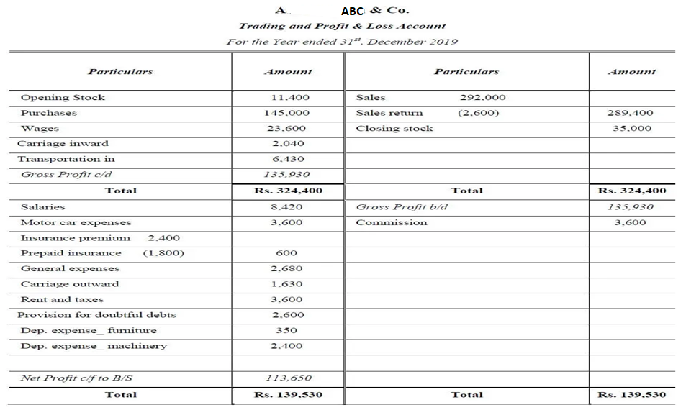

Slide 20
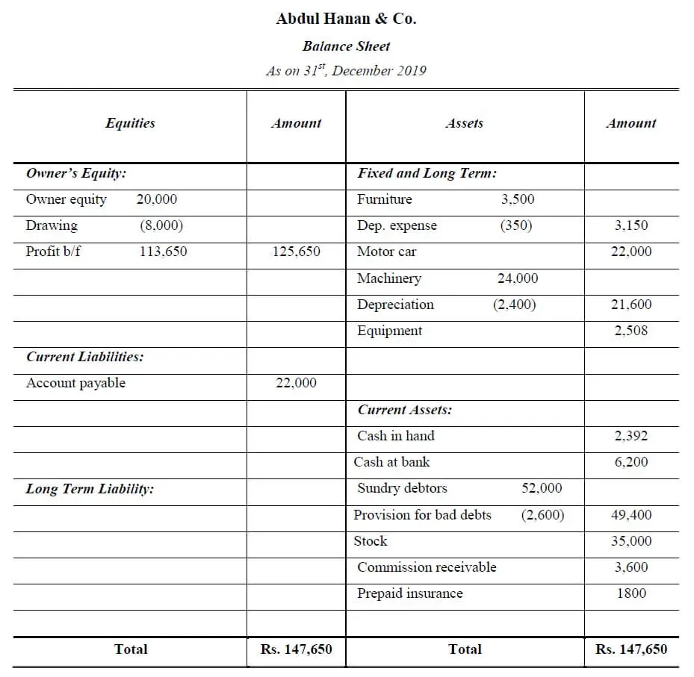

Slide 21
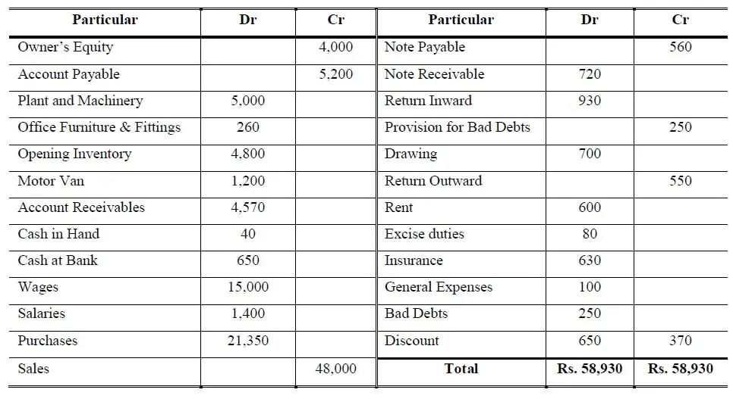
The following Trial Balance of Mr ABC co.Pvt Ltd on June 30th, 2020, Prepare Profit and Loss Account and Balance Sheet.

Slide 22
Adjustments:
Stock at the end of year Rs. 5,200 and Three months Excise duties is due, but not paid Rs. 30.
5 percent depreciation to be written-off on furniture and write-off further bad debts Rs. 70.
The provision for bad debts to be Rs. 300 and provision for discount on debtor @ 2 % to be made.
During the year machinery was purchased for Rs. 2,000, but was debited to Purchase account.

Slide 23
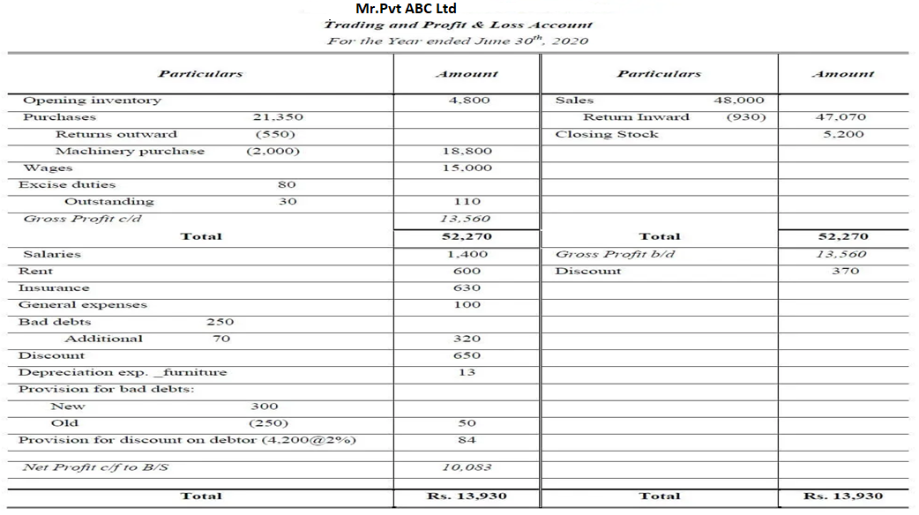

Slide 24
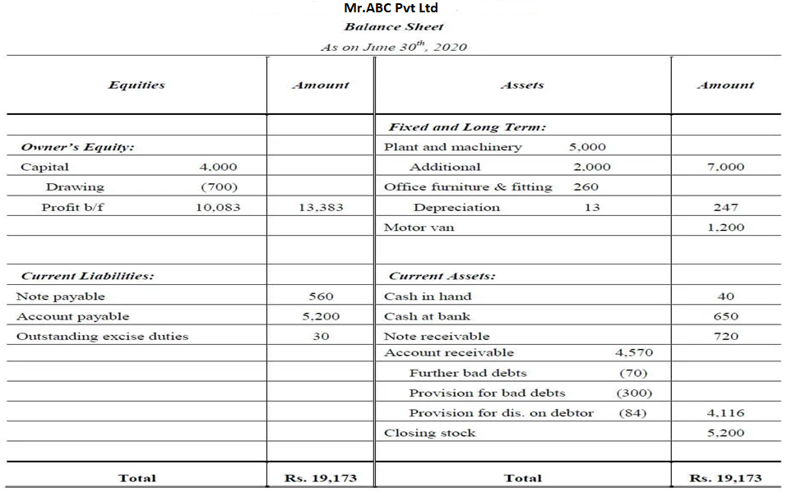

Slide 25
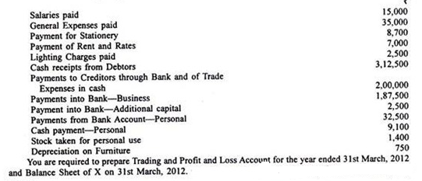
Transactions during the year ended 31st March, 2012 were as follows

Slide 26
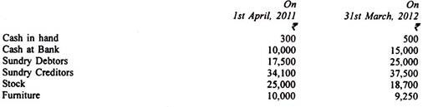
following information has been extracted from A”s accounting records:

Slide 27
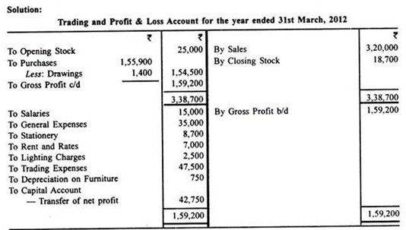
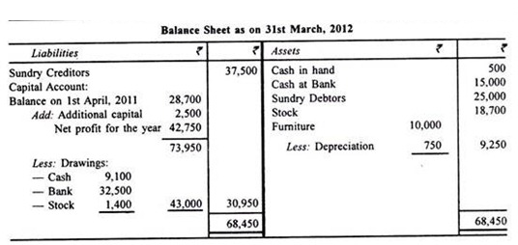

Slide 28
